Slide 1
CS210
Algorithms and Data Structures
Graphs
Week 11
Semester 1 2025
Dr. Pierpaolo Dondio

Slide 2
Week 11
Graph: definition
Representation of Graphs
Components
Searching in a Graph (DFS vs. BFS)
Shortest Path Algorithm

Slide 3
Graph: definition
A is a data structure defined as GRAPH G = (V, E) where
V is a set of vertices (nodes), and
E is a set of edges (arcs), i.e., pairs of vertices
DIRECTED graphs (digraphs): edges are directed
UNDIRECTED graphs: edges are undirected
Labeled graphs: edges have labels, directed or undirected
a
a
b
g
b
d
e
d
c
f
h
c
e
j
i

Slide 4
Graph representation: Adjacency Matrix
Use a square matrix (2d-array) where cell at position (i,j) is 1 if there is a link from node i to node j, 0 otherwise.
G=(V,E) and V={v₁,…,v_{N}}
A(i,j) = 1 if (v_{i},v_{j}) is in E, A(i,j) = 0 otherwise
Space: O(N²)
Edge insertion/deletion: O(1)
Find all adjacent vertices to a vertex: O(N)
If the graph is undirected, the matrix is always symmetrical
If we want to show weights on the edges, we use them in the matrix instead of using only 0 or 1
Examples?

Slide 5
Adjacency Matrix
 | a | b | c | d | e
a |  | 1 |  | 1 | 1
b | 1 |  | 1 | 1
c |  | 1 |  | 1 | 1
d | 1 | 1 | 1
e | 1 |  | 1
a
b
d
e
 | a | b | c | d | e | f | g | h | i | j
a |  | 1 |  | 1
b |  |  | 1 |  |  | 1
c | 1 |  |  | 1 | 1
d |  |  |  |  | 1
e
f |  |  | 1
g |  |  |  |  |  | 1 |  | 1
h |  |  |  |  |  | 1 |  |  |  | 1
i |  |  |  |  |  |  |  | 1
j |  |  |  |  |  |  |  |  | 1
c
a
b
g
d
c
f
h
e
j
i

Slide 6
Adjacency List
All vertices adjacent to vi are stored in the list adj(v_{i})
Space: O(N+|E|)
Edge insertion: O(1)
Deletions: O(v), where v is the degree of the node
Find all adjacent vertices to a vertex O(v)
adj(a) = (b, d)
adj(b) = (c, f)
adj(c) = (a, d, e)
adj(d) = (e)
adj(e) = ()
adj(f) = (c)
adj(g) = (f, h)
adj(h) = (f, j)
adj(i) = (h)
adj(j) = (I)
a
b
g
d
c
f
h
e
j
i

Slide 7
Edge List
It is a list of all the edges in the graph in the form i,j
The number of entries is the number of edges
Edge insertion: O(1)
Edge deletion: O(N)
Find all adjacent vertices to a vertex: O(N)
(a,b)
(a,d)
(b,c)
(b,f)
(c,a)
(c,d)
(c,e)
(d,e)
(f,c)
(g,f)
(g,h)
(h,j)
(j,i)
(i,h)
a
b
g
d
c
f
h
e
j
i

Slide 8

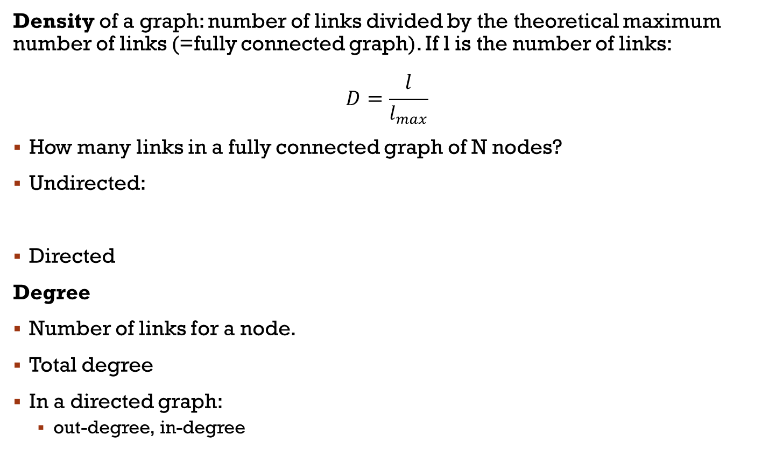

Some measurements
Density of a graph: number of links divided by the theoretical maximum number of links (=fully connected graph). If l is the number of links:
$$D=\frac{l}{l_{max}}$$
How many links in a fully connected graph of N nodes?
Undirected:
Directed
Degree
Number of links for a node.
Total degree
In a directed graph:
out-degree, in-degree
$$l_{max}=\frac{n\left(n−1\right)}{2}$$
$$l_{max}=n(n−1)$$
a
b
g
d
c
f
h
e
j
i

Slide 9
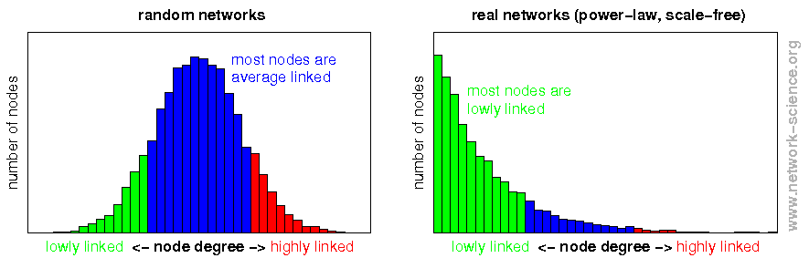
Degree distribution
It gives information about how degrees are distributed.
It is important to classify the type of graph/network

Slide 10
Paths
A PATH is a sequence of vertices v₁, …, v_{k} where each (vi , vi+1) is an edge
SIMPLE path: vi ¹ vj, except that v1 may be equal to v_{k}
Path LENGTH : number of edges in the path
A CYCLE: a path v₁, …, v_{k} such that v₁ = v_{k}
Examples: abdcea (undirected), hjihfcad (directed)
The geodesic distance between 2 nodes: length of the shortest path
a
a
b
g
b
d
e
d
c
f
h
c
e
j
i

Slide 11
Components
Reachable: Vertex a is reachable from b if a path exists from a to b.
Connected: A graph is connected if every vertex is reachable from any other.
Component: a set of vertices where every vertex can reach every other vertex by a directed path
A strongly connected component is a maximal set of vertices where every vertex can reach every other vertex by a directed path.
A weakly connected component is a maximal set of vertices that become connected if you ignore edge directions.
In an undirected path, weakly and strongly c. components are the same

Slide 12
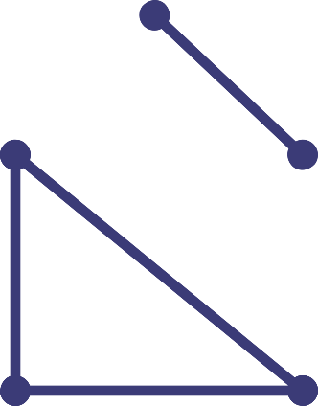
Connected Components (formally)
A connected component of graph G =(V,E ) with regard to
vertex v
is a set
C(v ) = {u ∈ V | there exists a path in G from u to v }.
In other words: If a graph is disconnected, then parts from which is composed from and that are themselves connected, are called connected components.
b
C(a)=C(b)={a,b}
c
a
C(c) =C(d) =C(e)={c,d,e}
e
d

Slide 13
Components / Examples
a
b
d
e
S = {a,b,c,d,e} (the entire graph)
c
a
b
g
S = {a,b,c} is a component, but not maximal
S={a,b,c,f} is a strongly connected component
S={h,i,j} is a strongly connected component
d
c
f
h
e
j
i

Slide 14
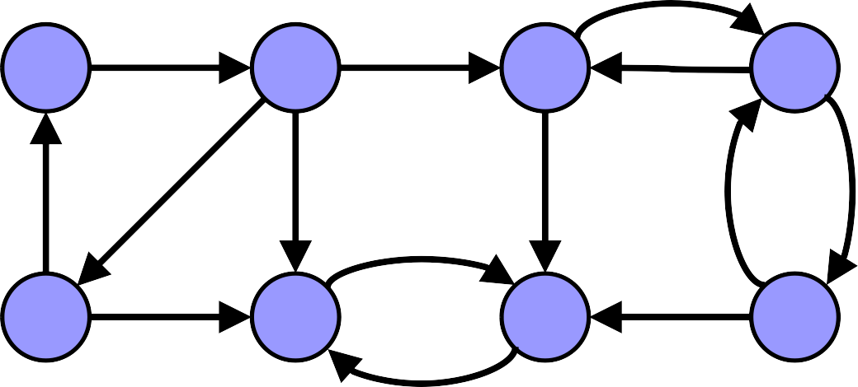
Connected Components (formally)
How to Find SCC
a
b
c
d
Any idea?
e
f
g
h
Easy but not completely efficient.
SCCs are the same in a graph and in the transpose graph (why?)
For each node, mark the one that can be reached
Transpose the graph
For each node, mark the one that can be reached in the transpose graph
For each node, the intersection of the 2 set of reachable nodes defines an SCC component

Slide 15
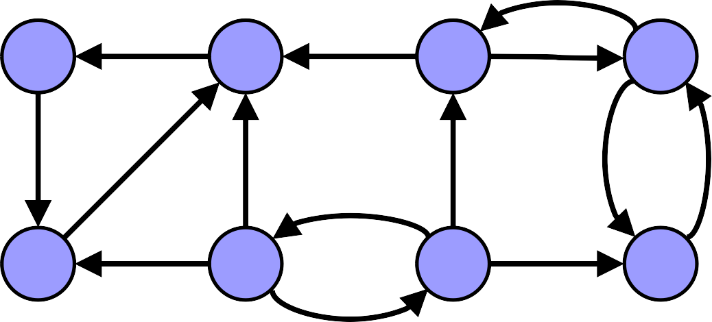
How can we find SCCs?
a
b
c
d
a
b
c
d
e
f
g
h
e
f
g
h
Node | Original Graph | Transpose | SCC
A | A,B,F,E,C,D,H,G
B
C
D
E
F
G
H

Slide 16
How can we find SCCs?
a
b
c
d
a
b
c
d
e
f
g
h
e
f
g
h
Node | Original Graph | Transpose | SCC
A | A,B,F,E,C,D,H,G | A,E,B
B
C
D
E
F
G
H

Slide 17
How can we find SCCs?
a
b
c
d
a
b
c
d
e
f
g
h
e
f
g
h
Node | Original Graph | Transpose | SCC
A | A,B,F,E,C,D,H,G | A,E,B | A,E,B
B
C
D
E
F
G
H

Slide 18
How can we find SCCs?
a
b
c
d
a
b
c
d
e
f
g
h
e
f
g
h
Node | Original Graph | Transpose | SCC
A | A,B,F,E,C,D,H,G | A,E,B | A,E,B
B | Already found
C
D
E | Already found
F
G
H

Slide 19
How can we find SCCs?
a
b
c
d
a
b
c
d
e
f
g
h
e
f
g
h
Node | Original Graph | Transpose | SCC
A | A,B,F,E,C,D,H,G | A,E,B | A,E,B
B | Already found
C | C,D,H,G,F
D
E | Already found
F
G
H

Slide 20
How can we find SCCs?
a
b
c
d
a
b
c
d
e
f
g
h
e
f
g
h
Node | Original Graph | Transpose | SCC
A | A,B,F,E,C,D,H,G | A,E,B | A,E,B
B | Already found
C | C,D,H,G,F | C,B,A,E,D,H
D
E | Already found
F
G
H

Slide 21
How can we find SCCs?
a
b
c
d
a
b
c
d
e
f
g
h
e
f
g
h
Node | Original Graph | Transpose | SCC
A | A,B,F,E,C,D,H,G | A,E,B | A,E,B
B | Already found
C | C,D,H,G,F | C,B,A,E,D,H | C,D,H
D
E | Already found
F
G
H

Slide 22
How can we find SCCs?
a
b
c
d
a
b
c
d
e
f
g
h
e
f
g
h
Node | Original Graph | Transpose | SCC
A | A,B,F,E,C,D,H,G | A,E,B | A,E,B
B | Already found
C | C,D,H,G,F | C,B,A,E,D,H | C,D,H
D | Already found
E | Already found
F
G
H | Already found

Slide 23
How can we find SCCs?
a
b
c
d
a
b
c
d
e
f
g
h
e
f
g
h
Node | Original Graph | Transpose | SCC
A | A,B,F,E,C,D,H,G | A,E,B | A,E,B
B | Already found
C | C,D,H,G,F | C,B,A,E,D,H | C,D,H
D | Already found
E | Already found
F | F,G
G
H | Already found

Slide 24
How can we find SCCs?
a
b
c
d
a
b
c
d
e
f
g
h
e
f
g
h
Node | Original Graph | Transpose | SCC
A | A,B,F,E,C,D,H,G | A,E,B | A,E,B
B | Already found
C | C,D,H,G,F | C,B,A,E,D,H | C,D,H
D | Already found
E | Already found
F | F,G | F,G,E,B,A.H,D,C
G
H | Already found

Slide 25
How can we find SCCs?
a
b
c
d
a
b
c
d
e
f
g
h
e
f
g
h
Node | Original Graph | Transpose | SCC
A | A,B,F,E,C,D,H,G | A,E,B | A,E,B
B | Already found
C | C,D,H,G,F | C,B,A,E,D,H | C,D,H
D | Already found
E | Already found
F | F,G | F,G,E,B,A.H,D,C | F,G
G
H | Already found

Slide 26
How can we find SCCs?
a
b
c
d
a
b
c
d
e
f
g
h
e
f
g
h
Node | Original Graph | Transpose | SCC
A | A,B,F,E,C,D,H,G | A,E,B | A,E,B
B | Already found
C | C,D,H,G,F | C,B,A,E,D,H | C,D,H
D | Already found
E | Already found
F | F,G | F,G,E,B,A.H,D,C | F,G
G | Already found
H | Already found

Slide 27
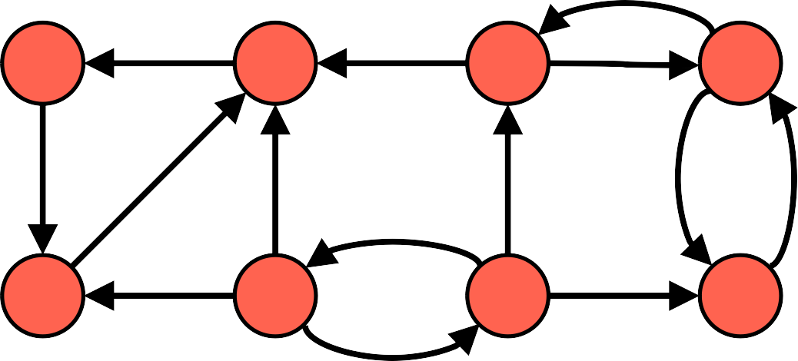
How can we find SCCs?
a
b
c
d
e
f
g
h
Node | Original Graph | Transpose | SCC
A | A,B,F,E,C,D,H,G | A,E,B | A,E,B
B | Already found
C | C,D,H,G,F | C,B,A,E,D,H | C,D,H
D | Already found
E | Already found
F | F,G | F,G,E,B,A.H,D,C | F,G
G | Already found
H | Already found

Slide 28
Searching: Breatdh First
First visit a level of the graph, then move to the “children” of each node that was not visited
BFS(graph, start):
create a queue Q
mark start as visited
enqueue start into Q
while Q is not empty:
v = dequeue Q
for each neighbor u of v:
if u is not visited:
mark u as visited
enqueue u
a
b
d
c
f
e
Enqueue = add to the queue

Slide 29
Searching: Breatdh First
Let’s visit the graph from node a
BFS(graph, start):
create a queue Q
mark start as visited
enqueue start into Q
while Q is not empty:
v = dequeue Q
for each neighbor u of v:
if u is not visited:
mark u as visited
enqueue u
a
b
d
c
f
e
Q
V

Slide 30
Searching: Breatdh First
Let’s visit the graph from node a
BFS(graph, start):
create a queue Q
mark start as visited
enqueue start into Q
while Q is not empty:
v = dequeue Q
for each neighbor u of v:
if u is not visited:
mark u as visited
enqueue u
a
b
d
c
f
e
Q
a
V
a

Slide 31
Searching: Breatdh First
Let’s visit the graph from node a
BFS(graph, start):
create a queue Q
mark start as visited
enqueue start into Q
while Q is not empty:
v = dequeue Q
for each neighbor u of v:
if u is not visited:
mark u as visited
enqueue u
a
b
d
c
f
e
remove a and add b
Q
b
V
a | b

Slide 32
Searching: Breatdh First
Let’s visit the graph from node a
BFS(graph, start):
create a queue Q
mark start as visited
enqueue start into Q
while Q is not empty:
v = dequeue Q
for each neighbor u of v:
if u is not visited:
mark u as visited
enqueue u
a
b
d
c
f
e
add d
Q
b | d
V
a | b | d

Slide 33
Searching: Breatdh First
Let’s visit the graph from node a
BFS(graph, start):
create a queue Q
mark start as visited
enqueue start into Q
while Q is not empty:
v = dequeue Q
for each neighbor u of v:
if u is not visited:
mark u as visited
enqueue u
a
b
d
c
f
e
remove b and add c
Q
d | c
V
a | b | d | c

Slide 34
Searching: Breatdh First
Let’s visit the graph from node a
BFS(graph, start):
create a queue Q
mark start as visited
enqueue start into Q
while Q is not empty:
v = dequeue Q
for each neighbor u of v:
if u is not visited:
mark u as visited
enqueue u
a
b
d
c
f
e
add f
Q
d | c | f
V
a | b | d | c | f

Slide 35
Searching: Breatdh First
Let’s visit the graph from node a
BFS(graph, start):
create a queue Q
mark start as visited
enqueue start into Q
while Q is not empty:
v = dequeue Q
for each neighbor u of v:
if u is not visited:
mark u as visited
enqueue u
a
b
d
c
f
e
add e
Q
c | f | e
V
a | b | d | c | f | e

Slide 36
Searching: Breatdh First
Let’s visit the graph from node a
BFS(graph, start):
create a queue Q
mark start as visited
enqueue start into Q
while Q is not empty:
v = dequeue Q
for each neighbor u of v:
if u is not visited:
mark u as visited
enqueue u
a
b
d
c
f
e
Q
V
a | b | d | c | f | e

Slide 37
Searching: Breatdh First
JAVA implentation
// Example graph as adjacency list
Map<Character, List<Character>> graph = new HashMap<>();
graph.put('a', new ArrayList<>(Arrays.asList('b', 'd')));
graph.put('b', new ArrayList<>(Arrays.asList('c', 'f')));
graph.put('c', new ArrayList<>(Arrays.asList('a', 'd')));
graph.put('d', new ArrayList<>(Arrays.asList('e')));
graph.put('e', new ArrayList<>());
graph.put('f', new ArrayList<>(Arrays.asList('c')));

Slide 38
Searching: Depth First
First visit the children of your neighbour node, before moving to the next neighbour (go as deep as possible along each branch before backtracking.)
DFS(graph, start):
create a stack S
mark start as visited
push start onto S
while S is not empty:
v = pop S
mark v as visited
for each neighbor u of v:
if u is not visited:
push u onto S
a
b
d
c
f
e
S
V

Slide 39
Searching: Depth First
First visit the children of your neighbour node, before moving to the next neighbour (go as deep as possible along each branch before backtracking.)
DFS(graph, start):
create a stack S
mark start as visited
push start onto S
while S is not empty:
v = pop S
mark v as visited
for each neighbor u of v:
if u is not visited:
push u onto S
a
b
d
c
f
e
PUSH a
S
a
V
a

Slide 40
Searching: Depth First
First visit the children of your neighbour node, before moving to the next neighbour (go as deep as possible along each branch before backtracking.)
DFS(graph, start):
create a stack S
mark start as visited
push start onto S
while S is not empty:
v = pop S
mark v as visited
for each neighbor u of v:
if u is not visited:
push u onto S
a
b
d
c
f
e
POP a PUSH b
S
b
V
a

Slide 41
Searching: Depth First
First visit the children of your neighbour node, before moving to the next neighbour (go as deep as possible along each branch before backtracking.)
DFS(graph, start):
create a stack S
mark start as visited
push start onto S
while S is not empty:
v = pop S
mark v as visited
for each neighbor u of v:
if u is not visited:
push u onto S
a
b
d
c
f
e
PUSH d
S
d | b
V
a

Slide 42
Searching: Depth First
First visit the children of your neighbour node, before moving to the next neighbour (go as deep as possible along each branch before backtracking.)
DFS(graph, start):
create a stack S
mark start as visited
push start onto S
while S is not empty:
v = pop S
mark v as visited
for each neighbor u of v:
if u is not visited:
push u onto S
a
b
d
c
f
e
POP d
S
b
V
a

Slide 43
Searching: Depth First
First visit the children of your neighbour node, before moving to the next neighbour (go as deep as possible along each branch before backtracking.)
DFS(graph, start):
create a stack S
mark start as visited
push start onto S
while S is not empty:
v = pop S
mark v as visited
for each neighbor u of v:
if u is not visited:
push u onto S
a
b
d
c
f
e
PUSH e
S
e | b
V
a | d

Slide 44
Searching: Depth First
First visit the children of your neighbour node, before moving to the next neighbour (go as deep as possible along each branch before backtracking.)
DFS(graph, start):
create a stack S
mark start as visited
push start onto S
while S is not empty:
v = pop S
mark v as visited
for each neighbor u of v:
if u is not visited:
push u onto S
a
b
d
c
f
e
POP e
S
b
V
a | d | e

Slide 45
Searching: Depth First
First visit the children of your neighbour node, before moving to the next neighbour (go as deep as possible along each branch before backtracking.)
DFS(graph, start):
create a stack S
mark start as visited
push start onto S
while S is not empty:
v = pop S
mark v as visited
for each neighbor u of v:
if u is not visited:
push u onto S
a
b
d
c
f
e
PUSH f, PUSH c
S
c | f | b
V
a | d | e

Slide 46
Searching: Depth First
First visit the children of your neighbour node, before moving to the next neighbour (go as deep as possible along each branch before backtracking.)
DFS(graph, start):
create a stack S
mark start as visited
push start onto S
while S is not empty:
v = pop S
mark v as visited
for each neighbor u of v:
if u is not visited:
push u onto S
a
b
d
c
f
e
POP c
S
f | b
V
a | d | e | c

Slide 47
Searching: Depth First
First visit the children of your neighbour node, before moving to the next neighbour (go as deep as possible along each branch before backtracking.)
DFS(graph, start):
create a stack S
mark start as visited
push start onto S
while S is not empty:
v = pop S
mark v as visited
for each neighbor u of v:
if u is not visited:
push u onto S
a
b
d
c
f
e
POP f
S
b
V
a | d | e | c | f

Slide 48
Searching: Depth First
First visit the children of your neighbour node, before moving to the next neighbour (go as deep as possible along each branch before backtracking.)
DFS(graph, start):
create a stack S
mark start as visited
push start onto S
while S is not empty:
v = pop S
mark v as visited
for each neighbor u of v:
if u is not visited:
push u onto S
a
b
d
c
f
e
POP b
S
V
a | d | e | c | f | b

Slide 49
Single-Source Shortest Path Problem
Dijkstra’s Algorithm solve Single-Source Shortest Path Problem - The problem of finding shortest paths from a source vertex v to all other vertices in the graph.
Core Idea
You keep track of the best known distance from the start to every node.
Next you always choose the unvisited node with the smallest known distance.
From that node, you try to improve the distances to its neighbors.
If going through this node gives a cheaper path to a neighbor, you update that neighbor’s distance.
Repeat until all reachable nodes have their best distances finalized.

Slide 50
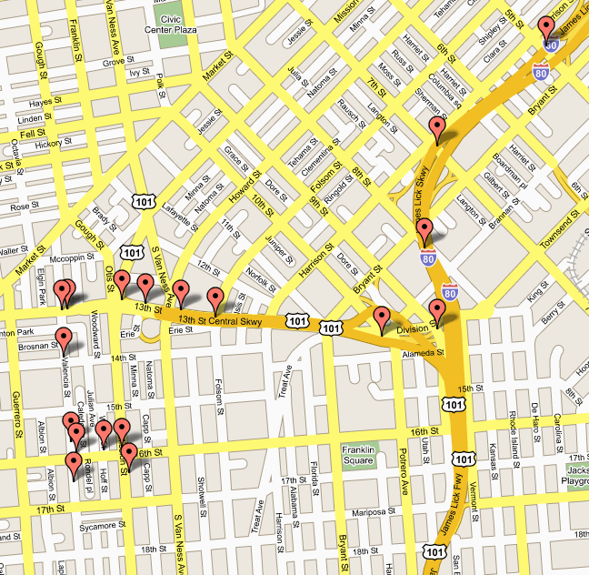
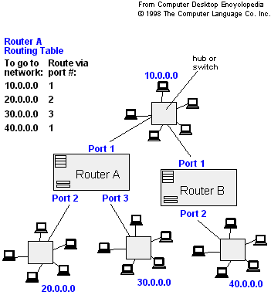
Applications
- Maps (Map Quest, Google Maps)
- Routing Systems

Slide 51
Dijkstra's algorithm
Dijkstra's algorithm - is a solution to the single-source shortest path problem in graph theory.
Works on both directed and undirected graphs. However, all edges must have nonnegative weights.
Input: Weighted graph G={E,V} and source vertex v∈V, such that all edge weights are nonnegative
Output: Lengths of shortest paths (or the shortest paths themselves) from a given source vertex v∈V to all other vertices

Slide 52
Approach
The algorithm computes for each vertex u the distance to u from the start vertex v, that is, the weight of a shortest path between v and u.
The algorithm keeps track of the set of vertices for which the distance has been computed, called the cloud C
Every vertex has a label D associated with it. For any vertex u, D[u] stores an approximation of the distance between v and u. The algorithm will update a D[u] value when it finds a shorter path from v to u.
When a vertex u is added to the cloud, its label D[u] is equal to the actual (final) distance between the starting vertex v and vertex u.

Slide 53
Pseudocode
Dijkstra(v1, v2):
for each vertex v: // Initialization
v's distance := infinity.
v's previous := none.
v1's distance := 0.
List := {all vertices}.
while List is not empty:
v := remove List vertex with minimum distance.
mark v as known.
for each unknown neighbor n of v:
dist := v's distance + edge (v, n)'s weight.
if dist is smaller than n's distance:
n's distance := dist.
n's previous := v.
reconstruct path from v2 back to v1, following previous pointers.

Slide 54
Example: Initialization
Distance(source) = 0
0
∞
Distance (all vertices but source) = ∞
A
2
B
N | D | Path
A | 0 | A
B | ∞
C | ∞
D | ∞
E | ∞
F | ∞
G | ∞
4
1
3
10
∞
C
2
D
2
E
∞
5
8
∞
4
6
F
1
G
∞
∞
Pick vertex in List with minimum distance.

Slide 55
Example: Update neighbors' distance
0
2
A
2
B
N | D | Path
A | 0 | A
B | 2 | AB
C | ∞
D | 1 | AD
E | ∞
F | ∞
G | ∞
4
1
3
10
∞
C
2
D
2
E
∞
5
8
1
4
6
F
1
G
∞
∞

Slide 56
Example: Remove vertex with minimum distance
0
2
A
2
B
N | D | Path
A | 0 | A
B | 2 | AB
C | ∞
D | 1 | AD
E | ∞
F | ∞
G | ∞
4
1
3
10
∞
C
2
D
2
E
∞
5
8
1
4
6
F
1
G
∞
∞
Pick vertex in List with minimum distance, i.e., D

Slide 57
Example: Update neighbors
0
2
A
2
B
N | D | Path
A | 0 | A
B | 2 | AB
C | 3 | ADC
D | 1 | AD
E | 3 | ADE
F | 9 | ADF
G | 5 | ADG
4
1
3
10
3
C
2
D
2
E
3
5
8
1
4
6
F
1
G
9
5

Slide 58
Example: Update neighbors
0
2
A
2
B
N | D | Path
A | 0 | A
B | 2 | AB
C | 3 | ADC
D | 1 | AD
E | 3 | ADE
F | 9 | ADF
G | 5 | ADG
4
1
3
10
3
C
2
D
2
E
3
5
8
1
4
6
F
1
G
9
5

Slide 59
Example: Continued...
Pick vertex in List with minimum distance (B) and update neighbors
0
2
A
2
B
N | D | Path
A | 0 | A
B | 2 | AB
C | 3 | ADC
D | 1 | AD
E | 3 | ADE
F | 9 | ADF
G | 5 | ADG
4
1
3
10
3
C
2
D
2
E
3
5
8
1
4
6
Note : distance(D) not updated since D is already known and distance(E) not updated since it is larger than previously computed
F
1
G
9
5

Slide 60
Example: Continued...
Pick vertex in List with minimum distance (B) and update neighbors
0
2
A
2
B
N | D | Path
A | 0 | A
B | 2 | AB
C | 3 | ADC
D | 1 | AD
E | 3 | ADE
F | 9 | ADF
G | 5 | ADG
4
1
3
10
3
C
2
D
2
E
3
5
8
1
4
6
F
1
G
9
5

Slide 61
Example: Continued...
Pick vertex List with minimum distance (E) and update neighbors
0
2
A
2
B
N | D | Path
A | 0 | A
B | 2 | AB
C | 3 | ADC
D | 1 | AD
E | 3 | ADE
F | 9 | ADF
G | 5 | ADG
4
1
3
10
3
C
2
D
2
E
3
5
8
1
4
6
F
1
G
We can reach G in 9 using E, but it is not better then the previous path, so no update
9
5

Slide 62
Example: Continued...
Pick vertex List with minimum distance (E) and update neighbors
0
2
A
2
B
N | D | Path
A | 0 | A
B | 2 | AB
C | 3 | ADC
D | 1 | AD
E | 3 | ADE
F | 9 | ADF
G | 5 | ADG
4
1
3
10
3
C
2
D
2
E
3
5
8
1
4
6
F
1
G
9
5

Slide 63
Example: Continued...
Pick vertex List with minimum distance (C) and update neighbors
0
2
A
2
B
N | D | Path
A | 0 | A
B | 2 | AB
C | 3 | ADC
D | 1 | AD
E | 3 | ADE
F | 8 | ADCF
G | 5 | ADG
4
1
3
10
3
C
2
D
2
E
3
5
8
1
4
6
F
1
G
8
5

Slide 64
Example: Continued...
Pick vertex List with minimum distance (C) and update neighbors
0
2
A
2
B
N | D | Path
A | 0 | A
B | 2 | AB
C | 3 | ADC
D | 1 | AD
E | 3 | ADE
F | 8 | ADCF
G | 5 | ADG
4
1
3
10
3
C
2
D
2
E
3
5
8
1
4
6
F
1
G
8
5

Slide 65
Example: Continued...
Pick vertex List with minimum distance (G) and update neighbors
0
2
A
2
B
N | D | Path
A | 0 | A
B | 2 | AB
C | 3 | ADC
D | 1 | AD
E | 3 | ADE
F | 6 | ADGF
G | 5 | ADG
4
1
3
10
3
C
2
D
2
E
3
5
8
1
4
6
F
1
G
6
5

Slide 66
Example (end)
0
2
A
2
B
N | D | Path
A | 0 | A
B | 2 | AB
C | 3 | ADC
D | 1 | AD
E | 3 | ADE
F | 6 | ADGF
G | 5 | ADG
4
1
3
10
3
C
2
D
2
E
3
5
8
1
4
6
F
1
G
6
5

Slide 67
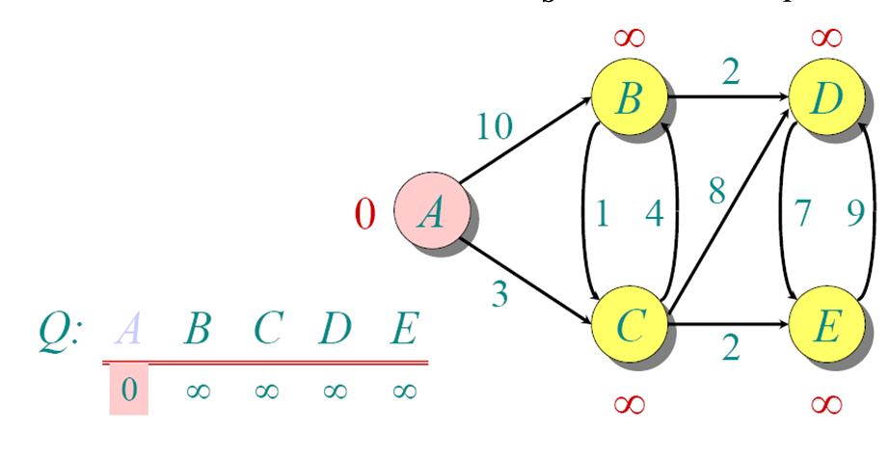
Another Example
N | Paths
B
C
D
E

Slide 68
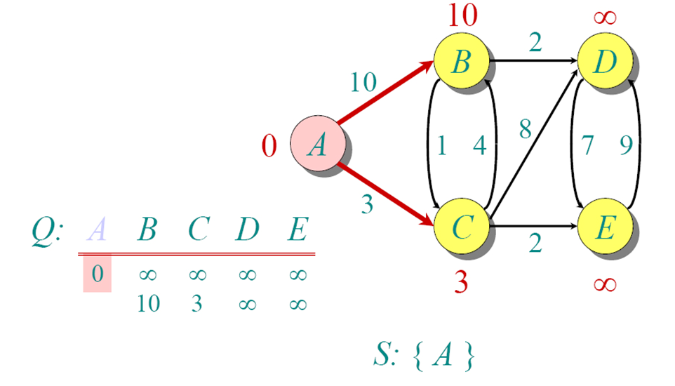
Another Example
N | Paths
B
C
D
E

Slide 69
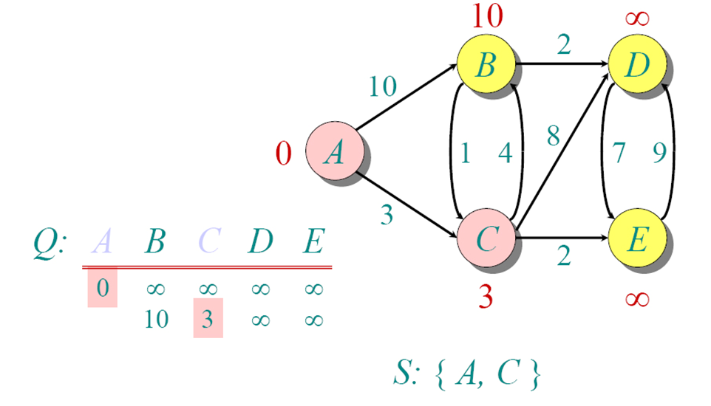
Another Example
N | Paths
B | AB
C | AC
D
E

Slide 70
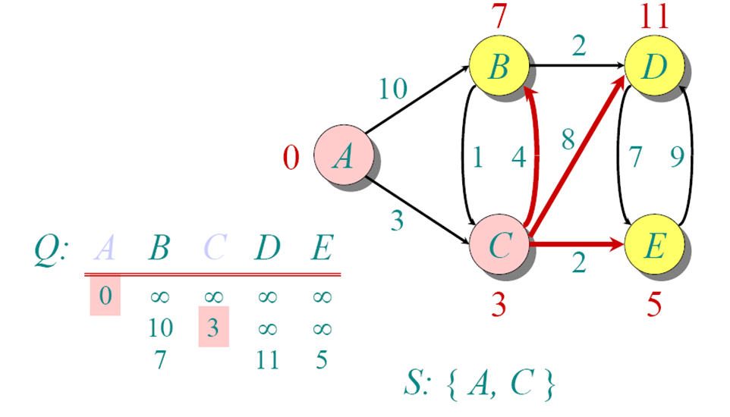
Another Example
N | Paths
B | ACB
C | AC
D | ACD
E | ACE

Slide 71
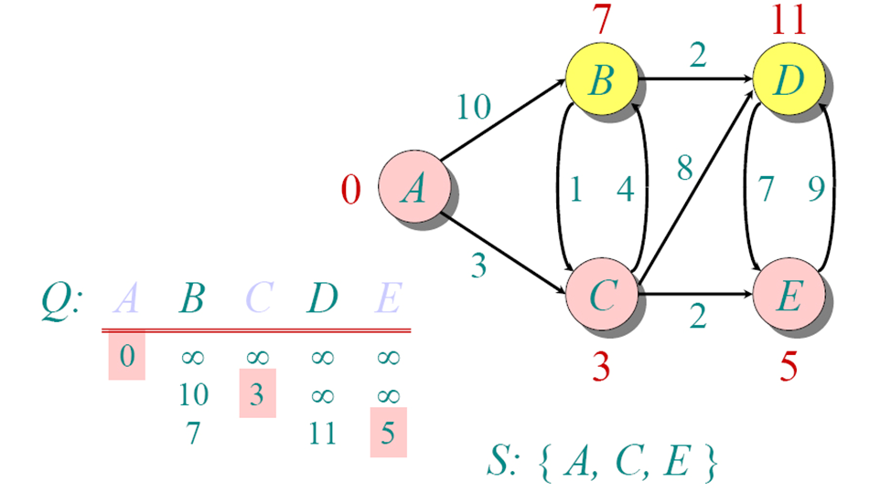
Another Example
N | Paths
B | ACB
C | AC
D | ACD
E | ACE

Slide 72
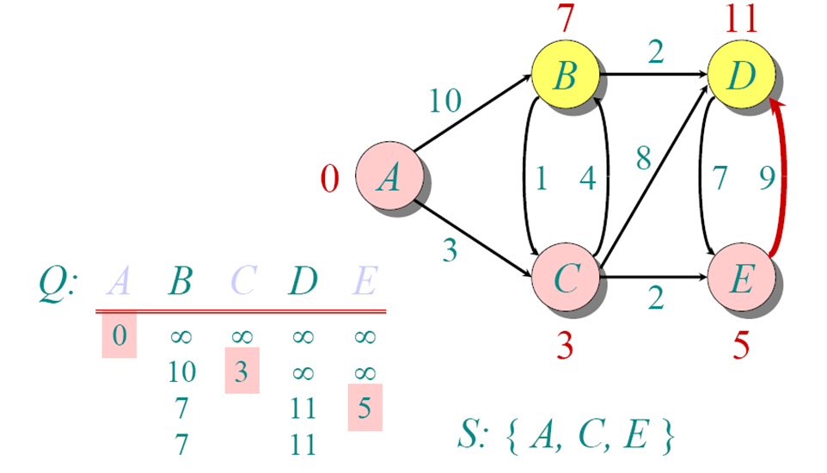
Another Example
N | Paths
B | ACB
C | AC
D | ACD
E | ACE

Slide 73
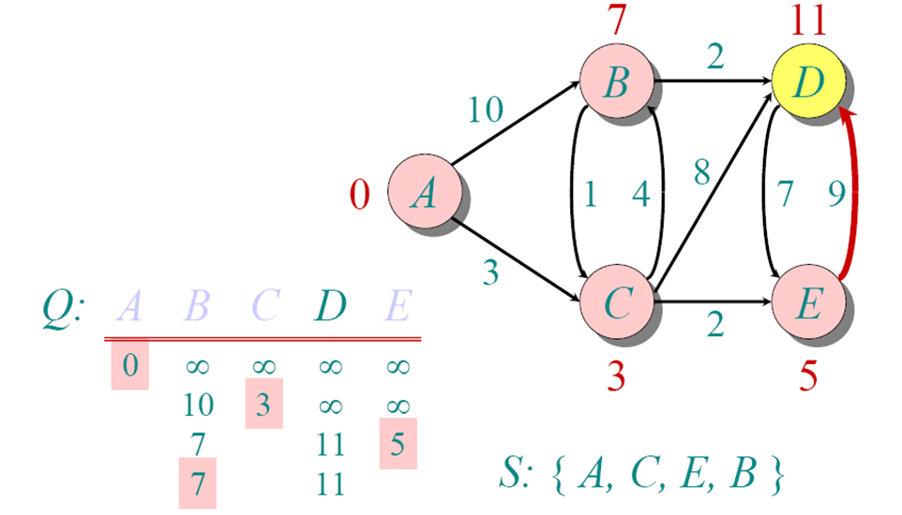
Another Example
N | Paths
B | ACB
C | AC
D | ACD
E | ACE

Slide 74
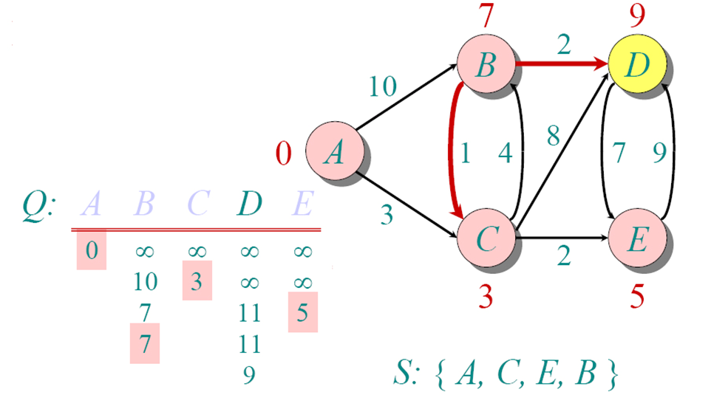
Another Example
N | Paths
B | ACB
C | AC
D | ACD
E | ACE

Slide 75
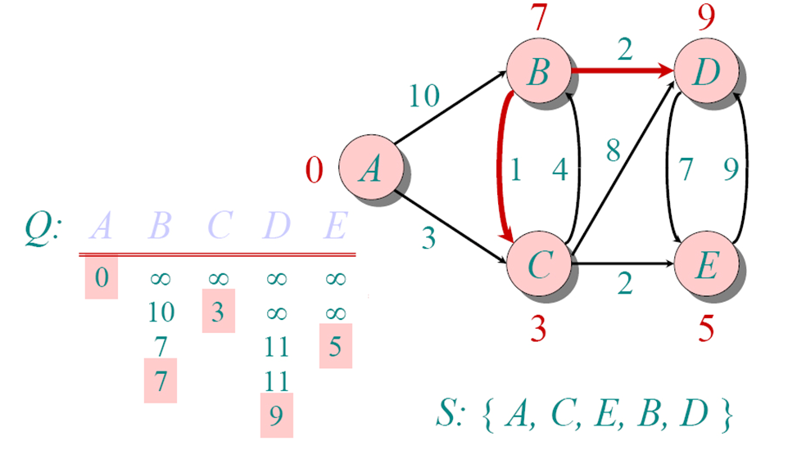
Another Example
N | Paths
B | ACB
C | AC
D | ACBD
E | ACE

Slide 76
Time Complexity
|V| vertices and |E| edges
Initialization takes O(|V|)
While loop takes O(|V|)
Find and remove min distance vertices O(|V|)
Potentially |E| updates
Update costs O(1)
Total time O(|V²| + |E|) = O(|V²| )
There are optimized version that reach: O(|E|log|V|)

Slide 77
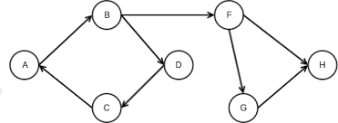
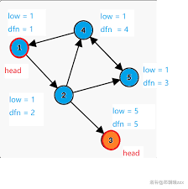
Exercises
Find the Strongly Connected components

Slide 78
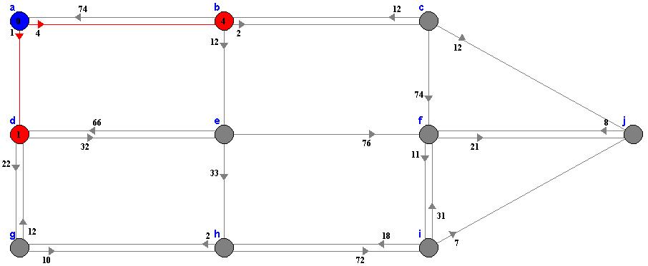
Exercises
Find the shortest paths form A to all the other nodes

